Slide 1
Result from July 3rd, 2025
SHRIMP U-Pb dating
2nd try

Slide 2
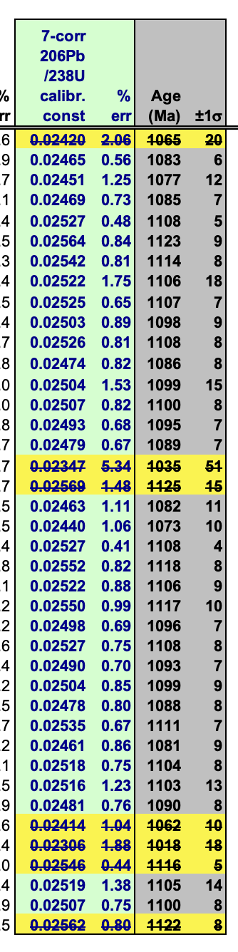
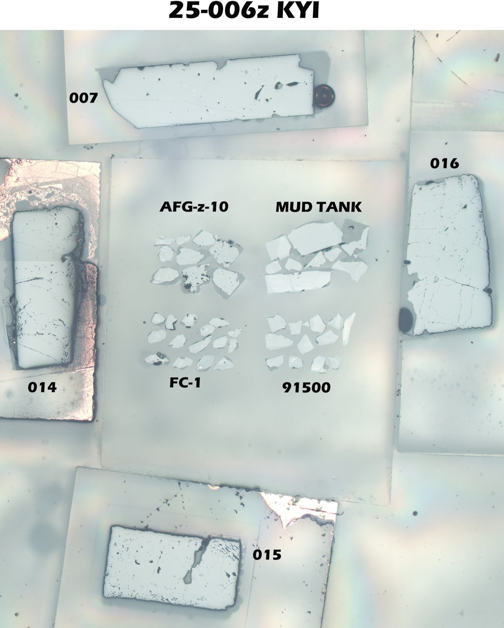
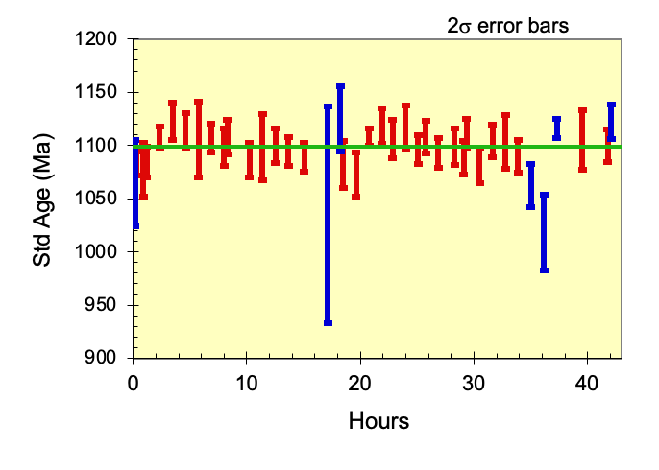
FC-1: 1099 Ma
primary reference zircon from Duluth complex
some drift in second day, but the uncertainty of each spot was much better than the 1st analysis

Slide 3
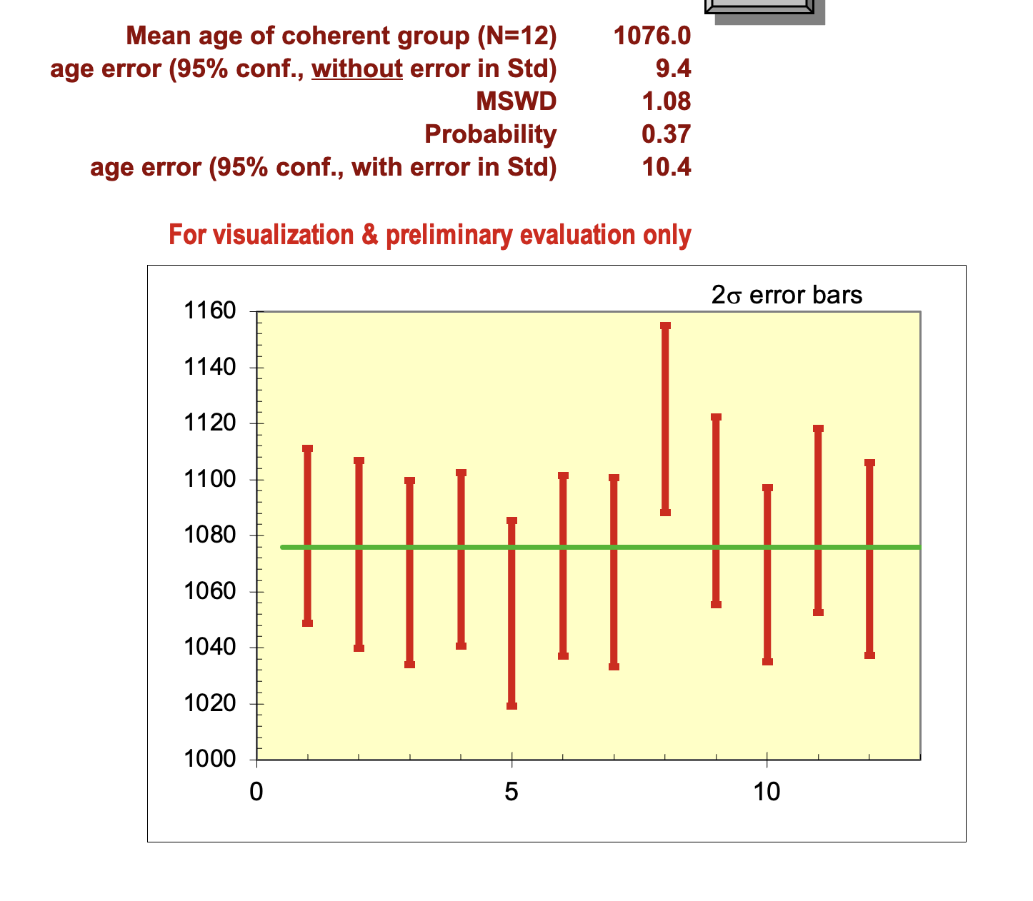
91500: 1062 Ma
secondary reference zircon
ages were older than suggested value. 1076 Ma = same as last time

Slide 4
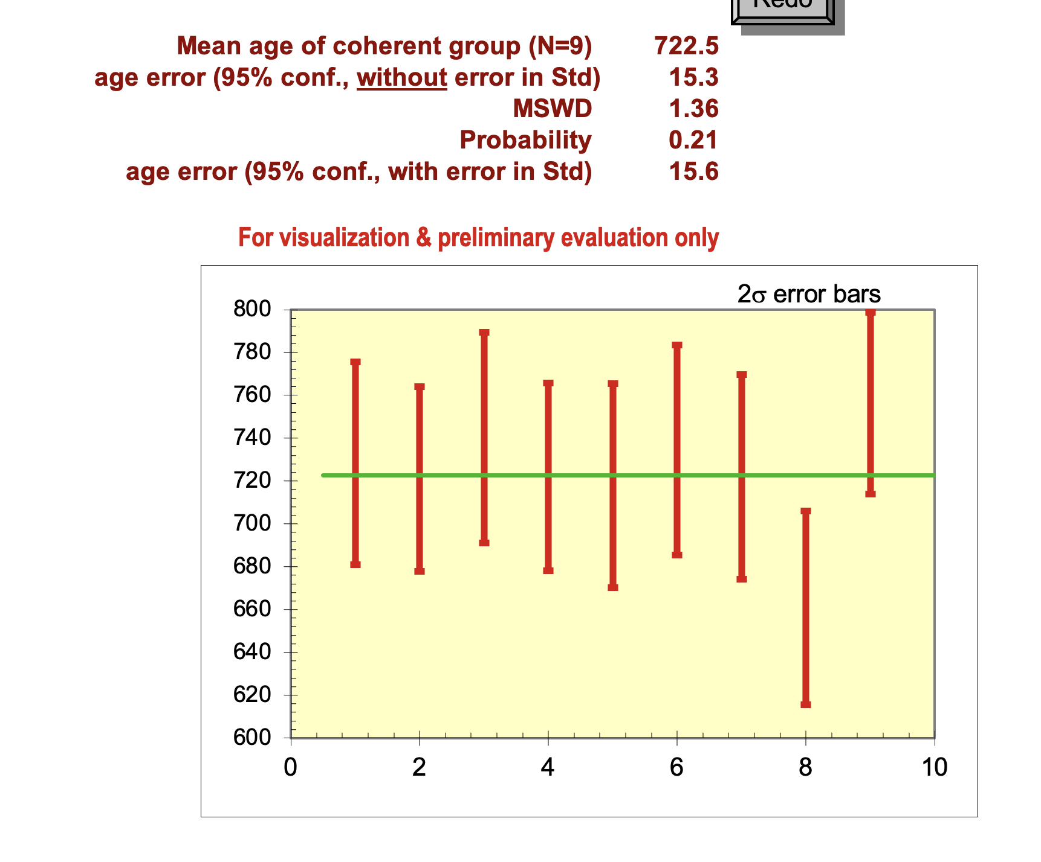
Mud tank: 701-722 or 731 Ma secondary reference zircon
I have to remove one outlier here (but not yet).

Slide 5
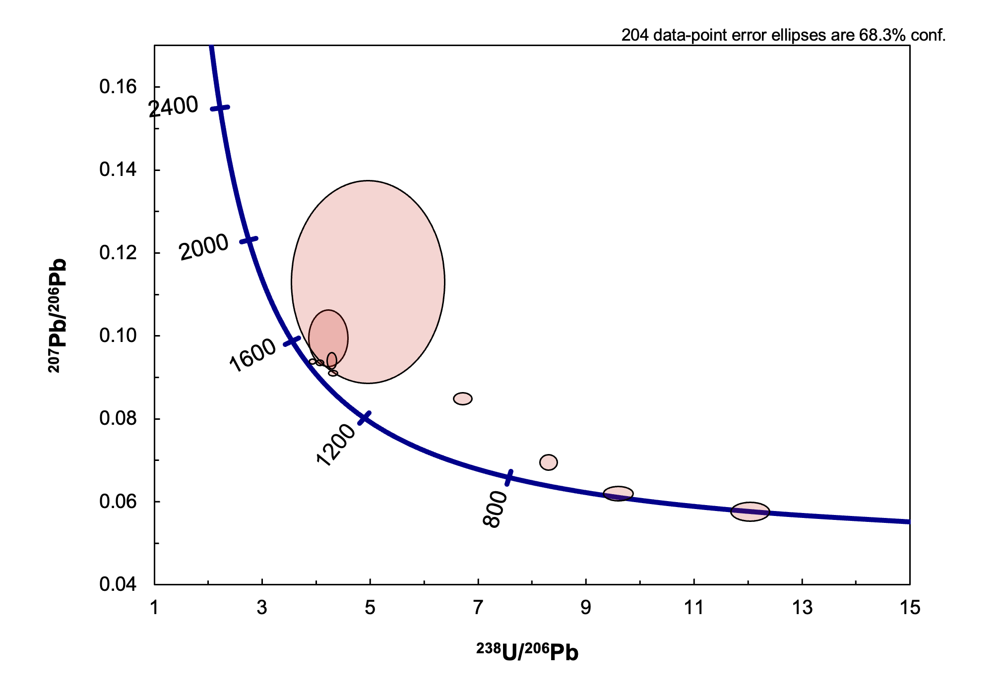
AFG-z-10
similar as last time

Slide 6
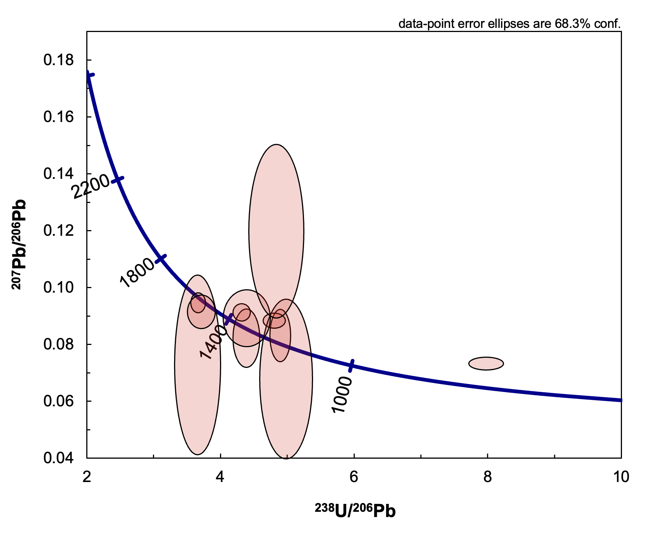
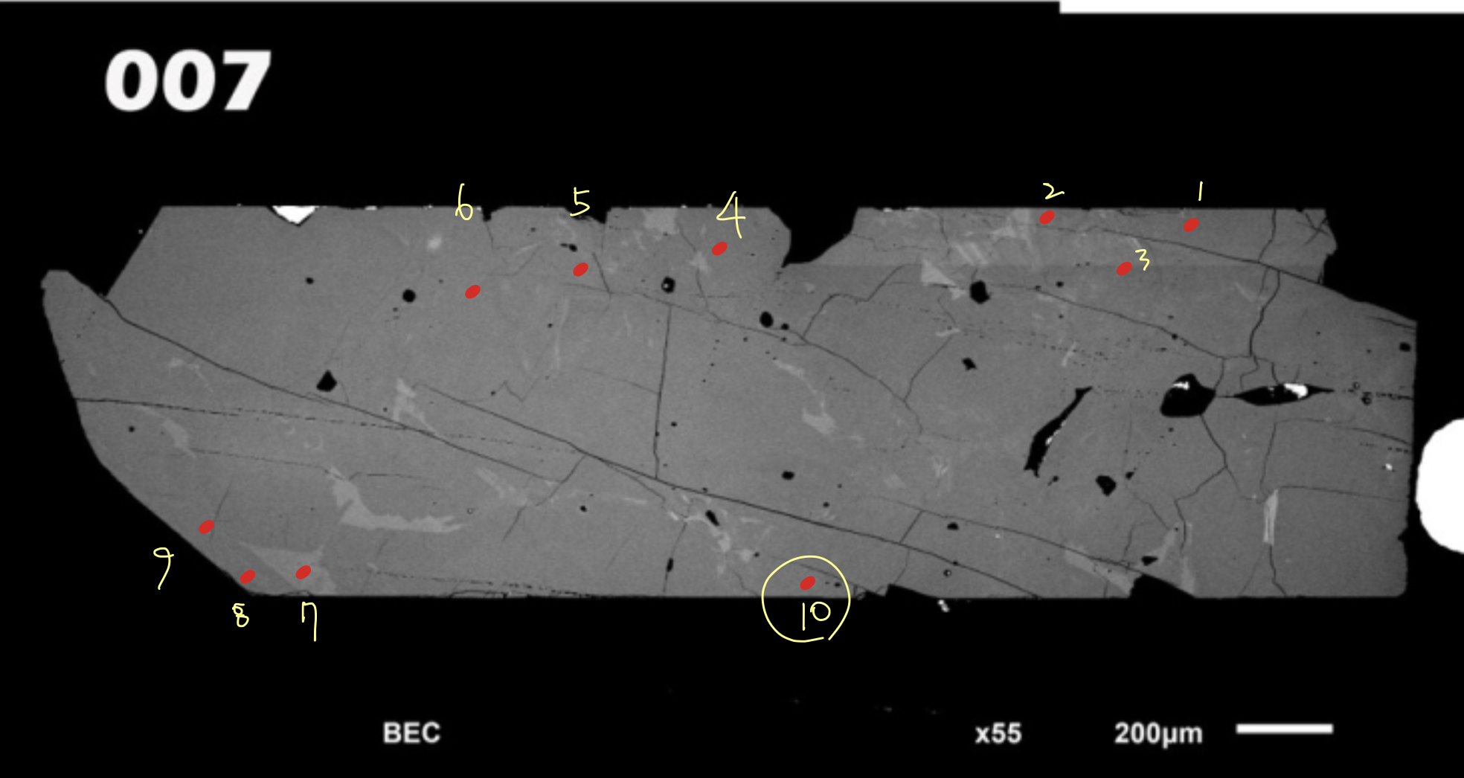

Slide 7
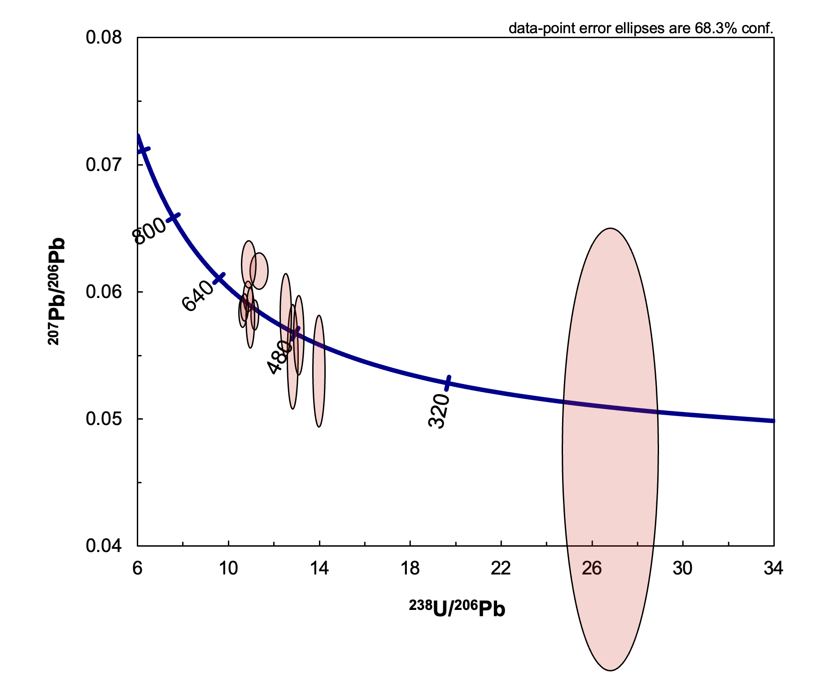
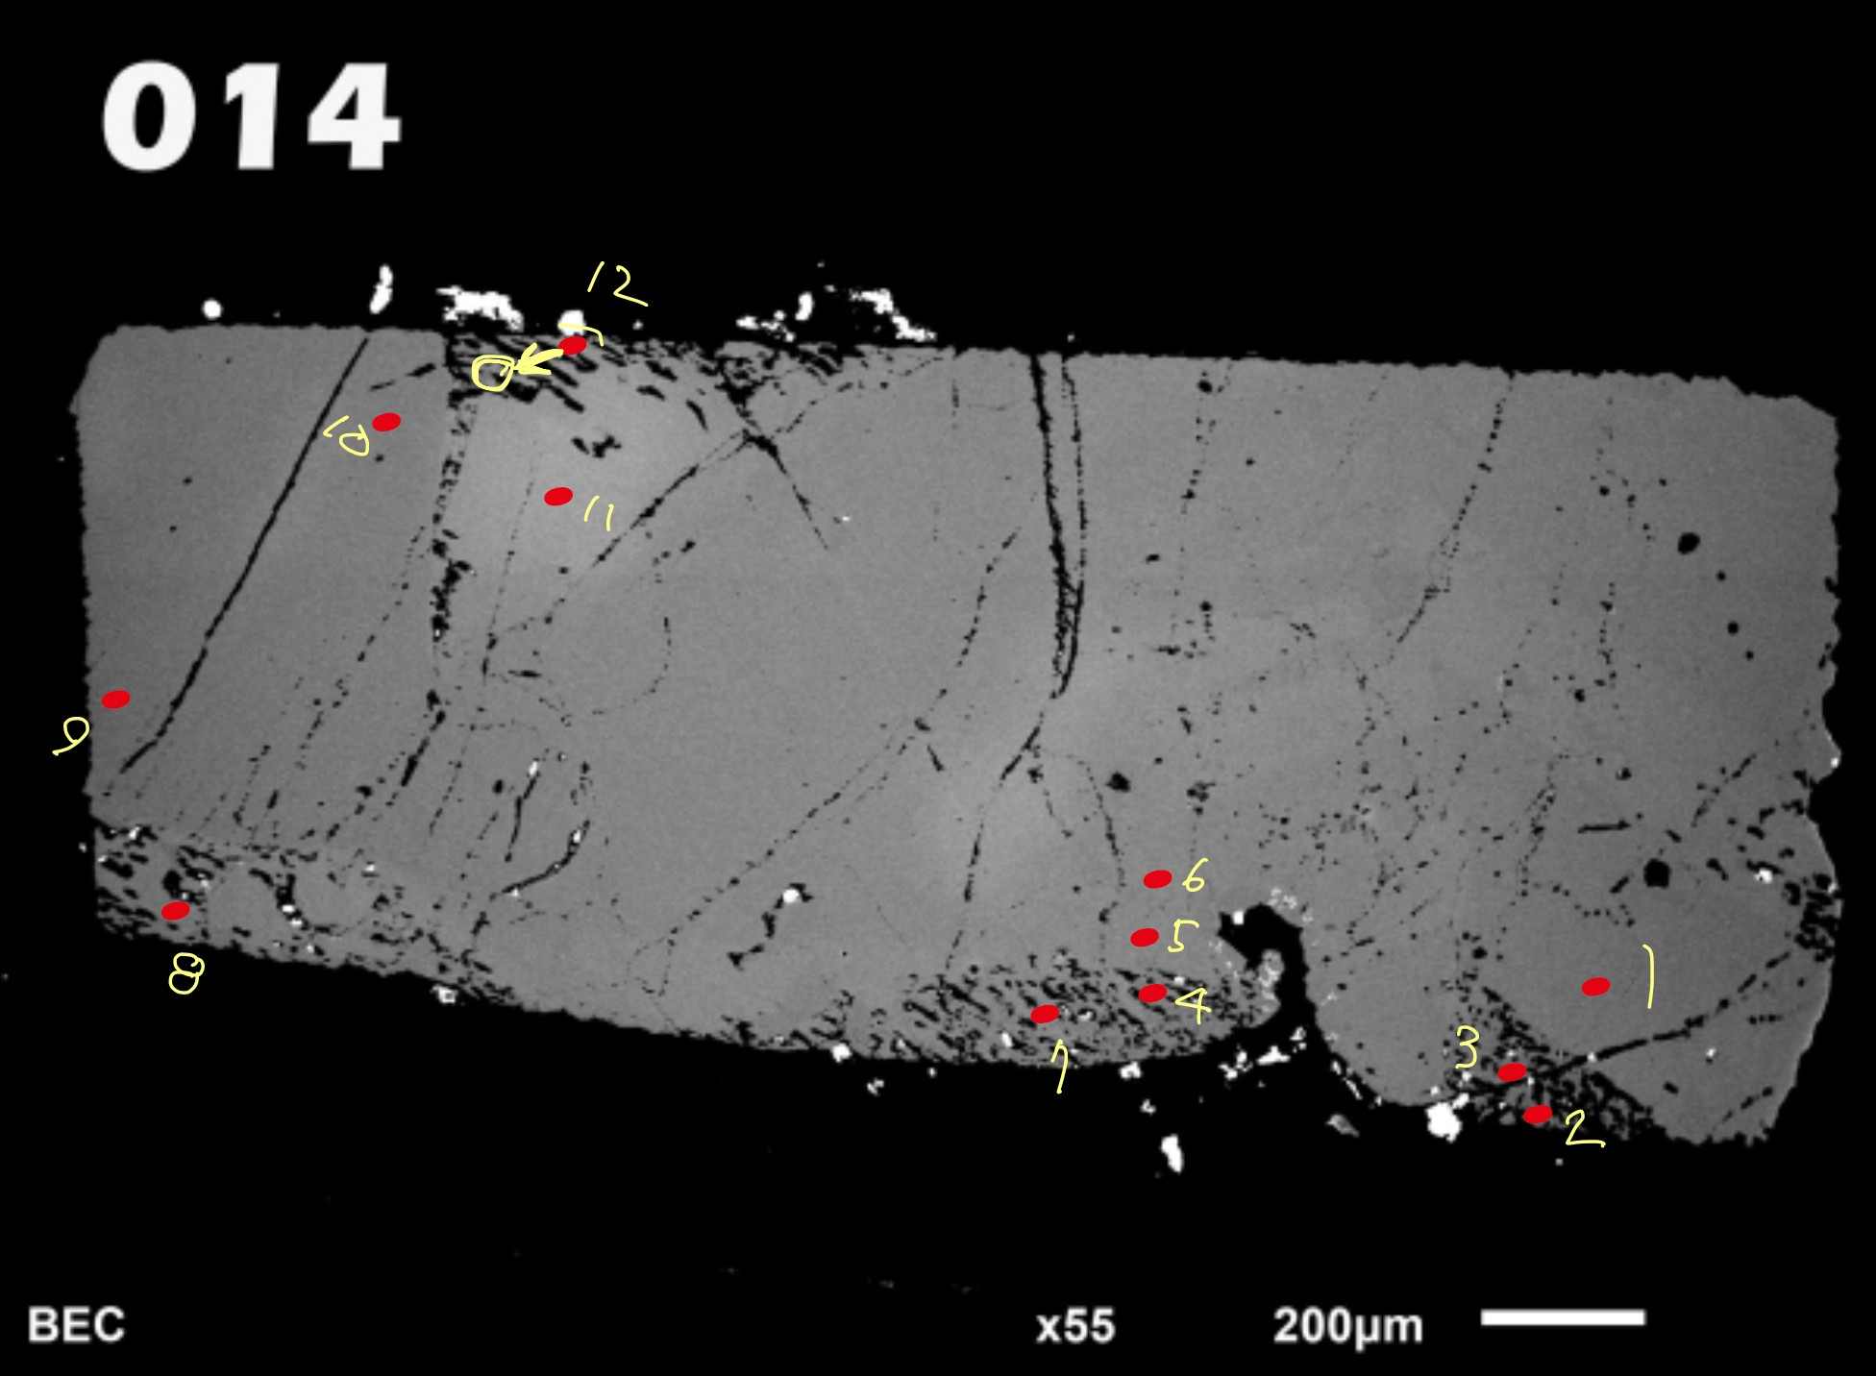

Slide 8
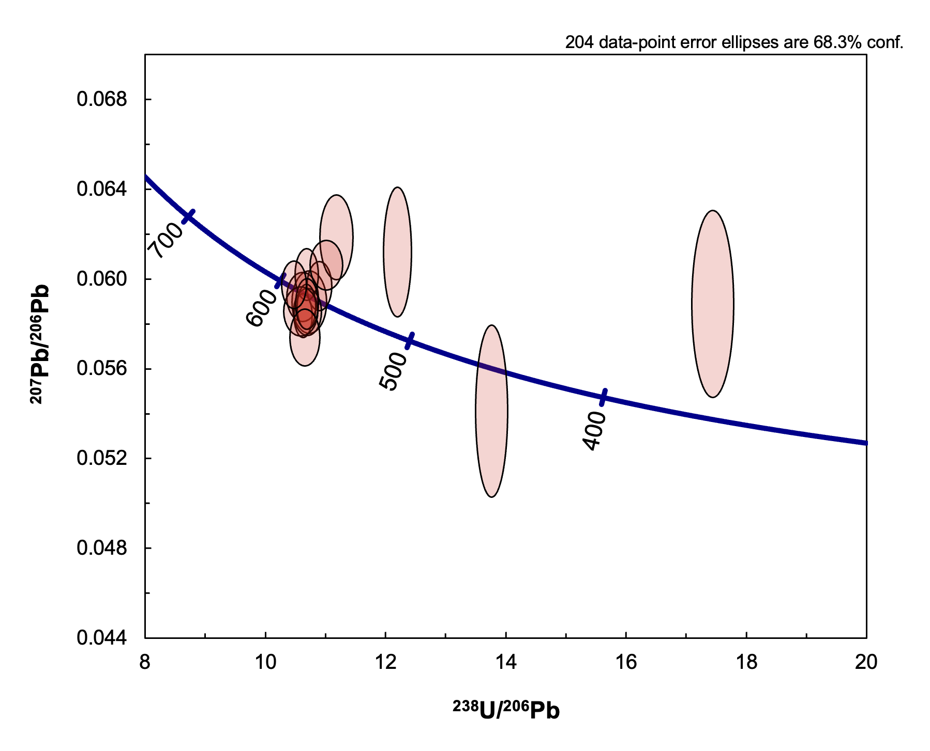
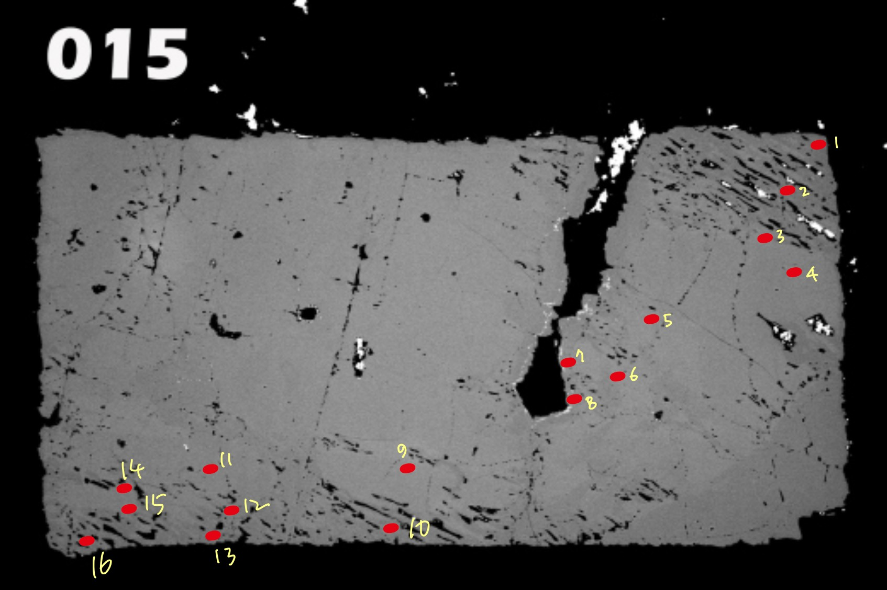

Slide 9
